Slide 1
Hello World!
Day 4 | Training IT Himastron

Slide 2
Run Python on Terminal
$ python
Python <version> (default, <date-update> [GCC 5.4.0 20160609] on linux2 Type "help", "copyright", "credits" or "license" for more information. >>> print(“Hello World”)

Slide 3
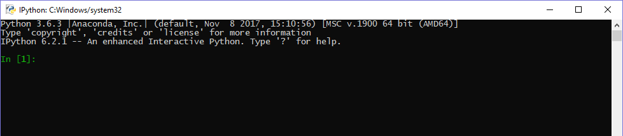
Run IPython
Open Start menu
Search IPython
Double click IPython

Slide 4
Run <filename>.py on terminal
Make new text file and add “print(‘Hello World’)”
Save as <filename>.py
open terminal and type
$ python <filename>.py

